Slide 1
SINO-US RELATIONS
[Korean War] [containment] [Taiwan Crises] [UN legal seat] [Nixon’s visit] [Shanghai Communique] [Aug17 Communique]
1949-1989
Presented by ZHANG Wei
Date_
2022/4/6
Based on Tao’s A Brief History of China-US Relations, chapter 7-9

Slide 2
01
THE KOREAN WAR
Campaigns and Offensives
Fighting & Talking in parallel
Armistice Agreement
Date_
2022/4/6
Sino-US Relations: 1949-1989
02

Slide 3
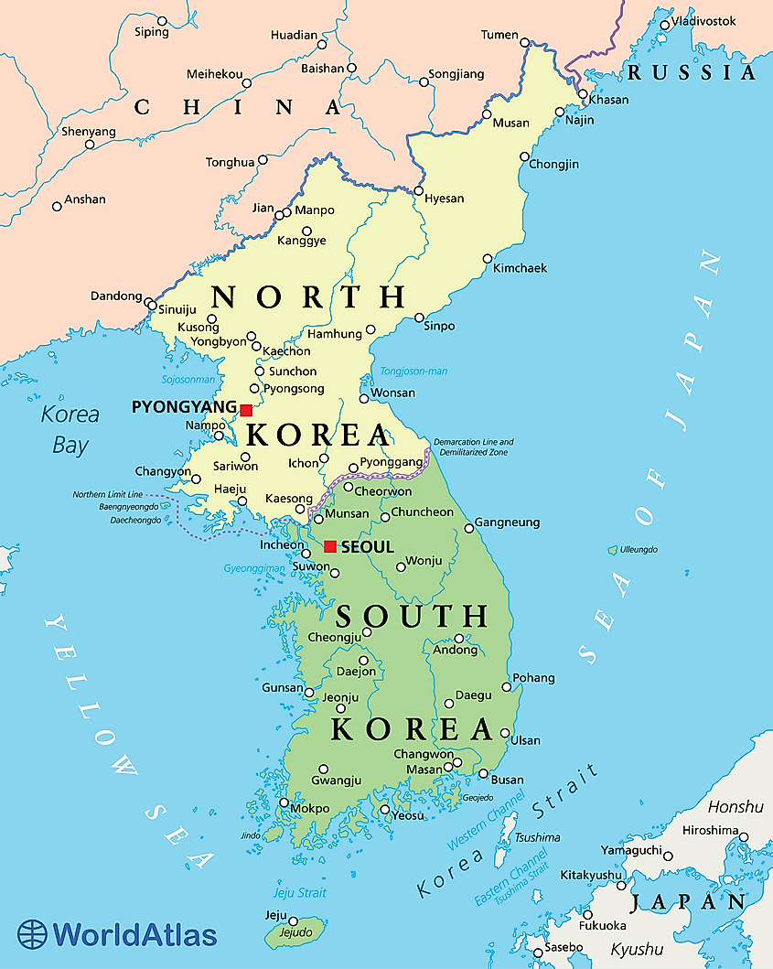
Basic Facts
Time: June 1950 – July 1953
Belligerents:
North Korea, People’s Republic of China, Soviet Union
South Korea, United Nations, United States
Stage I: Five campaigns
1st: Oct. 25, 1950 - Nov. 6, 1950
2nd: Nov. 25, 1950 - Dec. 25, 1950
3rd: Dec. 31, 1950 – Jan. 8, 1951
4th: Jan. 25, 1951 – Apr. 21, 1951
5th: Apr. 22, 1951 – Jun. 10, 1951
Stage II: Fighting & Talking
Sino-US Relations: 1949-1989 \\ the Korean War
03

Slide 4

Stage I: 1st Campaign(10.25-11.6)
China planed to build a defense base in Pyongyang; US captured Pyongyang; China took on the mobile force policy
China pushed back the enemies’ troops from the Yalu River to South of the Chongchong River
UNSC: a joint proposal by 6 countries (including the US)
“China border would not be violated and China’s interest in the border zone would be adequately protected, in exchange for the withdrawal of China’s troops from Korea”
Sino-US Relations: 1949-1989 \\ the Korean War
04

Slide 5


Stage I: 2st Campaign(11.25-12.25)
US NSC “the carefully designed trap of the Russians” & “find a line of defense we can defend” and then wait; MacArthur unhappy with the instructions was urged to implement them anyway.
CN forces recaptured Pyongyang, and all area north of the 13th parallel, some places south of it as well
UNGA, a ceasefire proposal by 13 countries including India and Afghanistan (rejected)
Sino-US Relations: 1949-1989 \\ the Korean War
05

Slide 6


Stage I: 3st Campaign(12.31-1.8)
China’s strategy of “steady progress”, go for quick victories but not make a rash advance by making too big a breech or advancing too far
CN troops occupied Seoul; AS troops were forced to retreat to areas near the 37th parallel
US: disagreements between and the Joint Chiefs of Staff
keep the war local vs. attacking China
a major war was unacceptable
Sino-US Relations: 1949-1989 \\ the Korean War
06

Slide 7


Stage I: 4st Campaign(1.25-4.21)
CN: three consecutive campaign victories resulted in overconfidence within Chinese and North Korean and an underestimation of the enemy
AS troops retook Seoul; CN troops retreated north of the 38th parallel
US Chief of staff seeking a political resolution; MacArthur insisting on his proposition to escalate the war; MacArthur was replaced by Ridgway
Sino-US Relations: 1949-1989 \\ the Korean War
07

Slide 8
Stage I: 5st Campaign(4.22-6.10)
The largest of the Korean War, with more than one million troops and 50 days of action
Both realized - if the war continued, neither side stood to gain anything but a heavy casualty toll.
considering armistice negotiations
1951/6/30. Ridgway proposed an armistice negotiation
1951/7/1. Kim II-sung and Peng Dehuai agreed
Sino-US Relations: 1949-1989 \\ the Korean War
08

Slide 9
Stage II: Fighting & Talking 52-53
sub-stage I: agreed not to talk about the withdrawal of all troops, and reached an agreement on the agenda of the negotiations
sub-stage II: on the military demarcation line
sub-stage II: on POW exchange
Sino-US Relations: 1949-1989 \\ the Korean War
09

Slide 10
Stage II: Fighting & Talking 52-53
sub-stage II: on the military demarcation line
38th parallel vs current line of contact
Retreat 10km vs 38-68km vs 2km
AS Summer offensive and Fall offensive
CN offshore defensive operations
1951.11.27 a preliminary agreement
the demarcation line along the actual line of contact
Both pulling back 2 km
Sino-US Relations: 1949-1989 \\ the Korean War
010

Slide 11
Stage II: Fighting & Talking 52-53
sub-stage III: on POW exchange
POWs total numbers (166k,70k,83k)
All POWs vs Voluntary POWs
Panmunjom negotiations
1952.9 resumed fierce offensive and defensive combat
1953.3 Zhou Enlai proposal: the immediate repatriation after armistice of all interned POWs who insisted on repatriation and transfer the remaining POWs to neutral countries so as to insure a fair solution to their repatriation
Sino-US Relations: 1949-1989 \\ the Korean War
011

Slide 12
POWs
Indirectly repatriated
Custody of a repatriation committee of neutral countries
Directly repatriated
Settled, Repatriated within 90 days
Not settled,
Political conference for settlement within 30 days
settled
Not settled, removal of POW status
Agreement on POW exchange reached on May 25, 1953

Slide 13
Stage III: Armistice Agreement
1953.7.27
Both sides singed the armistice agreement which came into immediate effect and brought the war to an end.
Implications - hostility between China and the US for a considerable time to come
Sino-US Relations: 1949-1989 \\ the Korean War
013

Slide 14
02
US Containment
UN Seat & embargo
Peaceful liberation of Tibet
KMT in Taiwan
Indochina, Japan and Southeast Asia policies
Date_
2022/4/6
Sino-US Relations: 1949-1989
014

Slide 15
🇺🇳
CHINA
🇨🇳
to revoke all rights of the “ROC”
to get recognition as P5
supported by Soviet delegation
UNITED STATES
🇺🇸
Owing to America’s obstruction, the question of China’s seat in the UN did not see much progress;
Sino-US Relations: 1949-1989 \\ containment
015

Slide 16
💰
UNITED STATES
🇺🇸
American trade controls toward China (NSC41,NSC48)
Asked its aid recipient countries for same controls
A comprehensive license system on exports to Chinese mainland
CHINA’S REACTION
🇨🇳
Held local produce and material exchange meetings
Focused on trade with the Soviet Union and Eastern Europe
Changed trade model
Sino-US Relations: 1949-1989 \\ containment
016

Slide 17

💰
UNITED STATES
🇺🇸
American trade controls toward China (NSC41,NSC48)
Asked its aid recipient countries for same controls
A comprehensive license system on exports to Chinese mainland
Japan and Britain asked for relaxation
Domestic voice asked for relaxation
The embargo was kept throughout the 1950s and the 1960s
CHINA’S REACTION
🇨🇳
Held local produce and material exchange meetings
Focused on trade with the Soviet Union and Eastern Europe
Changed trade model
Sino-US Relations: 1949-1989 \\ containment
017

Slide 18
03
Taiwan Crises
First crisis
Second crisis
Date_
2022/4/6
Sino-US Relations: 1949-1989
018

Slide 19
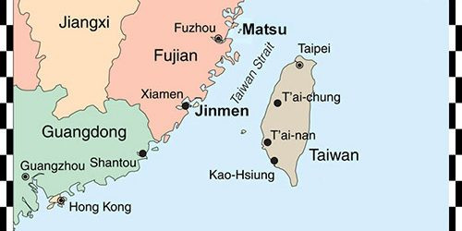
Previously
the Seventh Fleet to Taiwan
NSC48 providing military and economic assistance to Taiwan
US Military Advisory Assistance Group (MAAG)
Eisenhower’s different policy toward Taiwan; no commitment to the Taiwan authority
Chiang Kai-shek eager to conclude a mutual defense treaty with the US
Mainland China worried that US and Taiwan signed a treaty and would lead to a similar situation to the Korean peninsular
Meeting #001 | 15 participants | Action name AB43215C
019

Slide 20
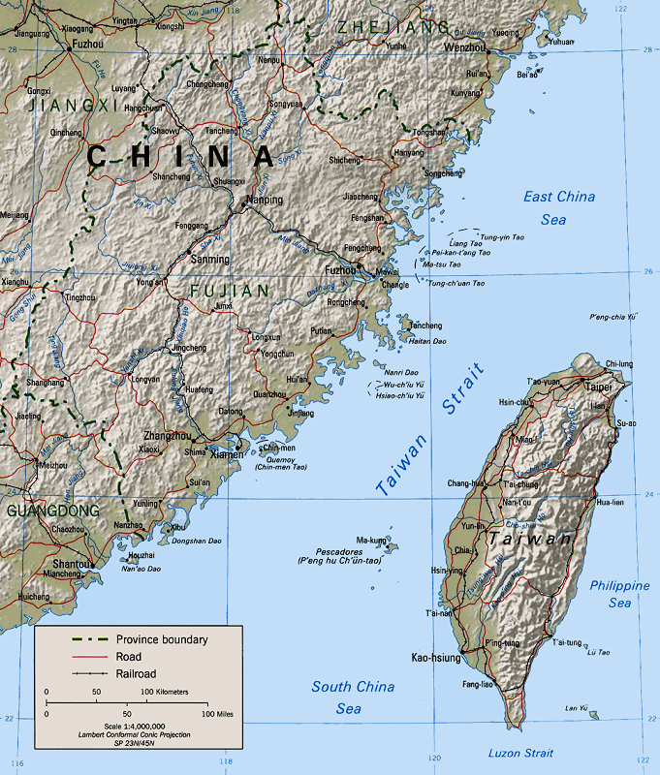
The 1st Crisis:1954-1955
9.3 PLA forces in Fujian started a heavy bombardment of Jinmen
Eisenhower: US should not involve itself into a major war and at the same time US could not publicly declare it was abandoning Taiwan
UN New Zealand ceasefire proposal
US tried to convince Chiang to accept the proposal but failed;
later Chiang agreed, asking the US to sign a mutual defense treaty with Taiwan in return
Sino-US Relations: 1949-1989 \\ the Taiwan Crises
020

Slide 21
The 1st Crisis:1954-1955
1954.12.2 “Mutual Defense Treaty Between the United States of America and the Republic of China” was signed
“each party recognizes that an armed attack in the West Pacific area directed against the territories of either of the parties would be dangerous to its own peace and safety and declares that it would act to meet the common dander in accordance with its constitutional processes.”
territories shall mean Taiwan [Formosa] and the Penghu Island [Pescadores]
Sino-US Relations: 1949-1989 \\ the Taiwan crises
021

Slide 22
The 1st Crisis:1954-1955
1954.12.2 “Mutual Defense Treaty Between the United States of America and the Republic of China” was signed
if Taiwan were to use military force against the mainland, it must first get agreement from the US
The treaty
was intended to make permanent the isolation of Taiwan from the mainland (Tao)
Zhou regarded it as: “a barefaced treaty of aggression”, “illegal and invalid”
Sino-US Relations: 1949-1989 \\ the Taiwan crises
022

Slide 23
The 1st Crisis:1954-1955
disputes on Yijiangshan and Dachens
1955.2.25 all island along the coast of eastern Zhejiang were liberated
UN New Zealand ceasefire proposal 2.0
countered by a Soviet Union proposal
Asian-African Conference, direct China-US negotiations were finally realized, a brief lessening of tension
Sino-US Relations: 1949-1989 \\ the Taiwan crises
023

Slide 24
The 2nd Crisis:1958
US sent troops to Lebanon, China demanding the withdrawal of these troops
China launched another large-scale artillery bombardment of Jinmen
US response, reinforced the seventh fleet
1958.9.3 China suspend the bombardment, and issued a statement of “12 nautical miles”, including Taiwan (US refused to recognize)
Sino-US Relations: 1949-1989 \\ the Taiwan crises
024

Slide 25
The 2nd Crisis:1958
US-Taiwan conflict intensified
Chiang wanted escalation
US wanted negotiation
1958.10 China-US ambassadorial negotiations had been resumed
1958.10.23 US Taiwan reached a joint communique
make permanent the separation
mainland,
published several articles on People’s Daily, “Letter to Compatriots in Taiwan”, draw a line between civil war and foreign aggression
leave Jinmen and Mazu in the hands of the Taiwan and use this to oppose American attempts to make permanent the isolation of Taiwan from the mainland
Sino-US Relations: 1949-1989 \\ the Taiwan crises
025

Slide 26
04
Ambassadorial Talks
Geneva
Warsaw
Date_
2022/4/6
Sino-US Relations: 1949-1989
026

Slide 27
Ambassadorial Talks: 1955-1971
Geneva Conference | Chinese delegation to this conference actively sought to improve its relations with the US and consular-level contacts were established. 1954.7.29
Asian-African Conference | Zhou Enlai famous statement: "The Chinese people and American people are friendly to each other. The Chinese people do not want to fight a war against the US. The Chinese government will sit down with the US government to discuss the relaxation of tension in Far East, especially the relaxation of tension in the Taiwan region"
Ambassadorial talks | The talks - find out the intention, instead of reaching any concrete agreements Reduced to once a month after the Taiwan crisis (1964), Suspended after the 134th meeting on 1968.1.8 1970, Warsaw ambassadorial talks were resumed after two years in abeyance (135th)
Sino-US Relations: 1949-1989 \\ ambassadorial talks
027

Slide 28
05
Policy adjustments
China: Sino-Soviet relations
US: Fulbright,
Date_
2022/4/6
Sino-US Relations: 1949-1989
028

Slide 29
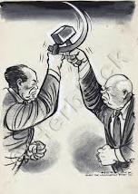
Deteriorating Sino-Soviet relations
due to disagreements with regard to
Nuclear nonproliferation,
remarks on Starlin,
several Border disputes,
the construction of a long-wave radio station in China,
the bombardment of Jinmen,
the Sino-Soviet strategic cooperation went into decline, and eventually an overall breach in July 1963.
the security environment for China changed greatly after the breach of Sino-Soviet cooperation, as a result there were several adjustments of China’s foreign policy in the 1960s
1968 ZhenBao Island incident
Sino-US Relations: 1949-1989 \\ policy adjustments
029

Slide 30
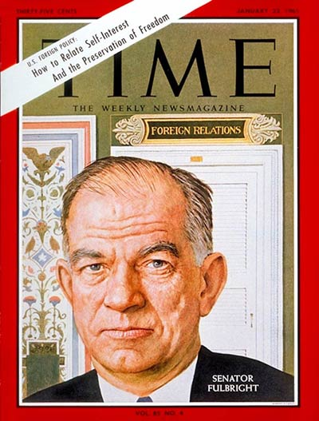
Politicians & scholars
Conlon report
Communist China is very likely to emerge as one of the major world power of the late 20th century;
the question is whether it can be persuaded or forced to bear any responsibility for its participation.
Kennedy and Johnson’s strategy
to exploit the Sino-Soviet disagreement to put pressure on China and adopt a more hostile policy to it
to prevent China from becoming a nuclear power
Others including William Fulbright and Doak Barnett led to a shift in American public opinion towards China
Sino-US Relations: 1949-1989 \\ policy adjustments
030

Slide 31
06
Normalization
Nixon’s visit and the first communique
The second communique
Date_
2022/4/6
Sino-US Relations: 1949-1989
031

Slide 32
The Road to Normalization
Nixon
Cater
Vance vs Brzezinski
2nd communique
Visit
1st communique
01
02
03
04
Ford
Reagan
laden with the heavy burden of rebuilding trust in government; no notable progress
Pro-Taiwan
3rd communique
Sino-US Relations: 1949-1989 \\ normalization
032

Slide 33
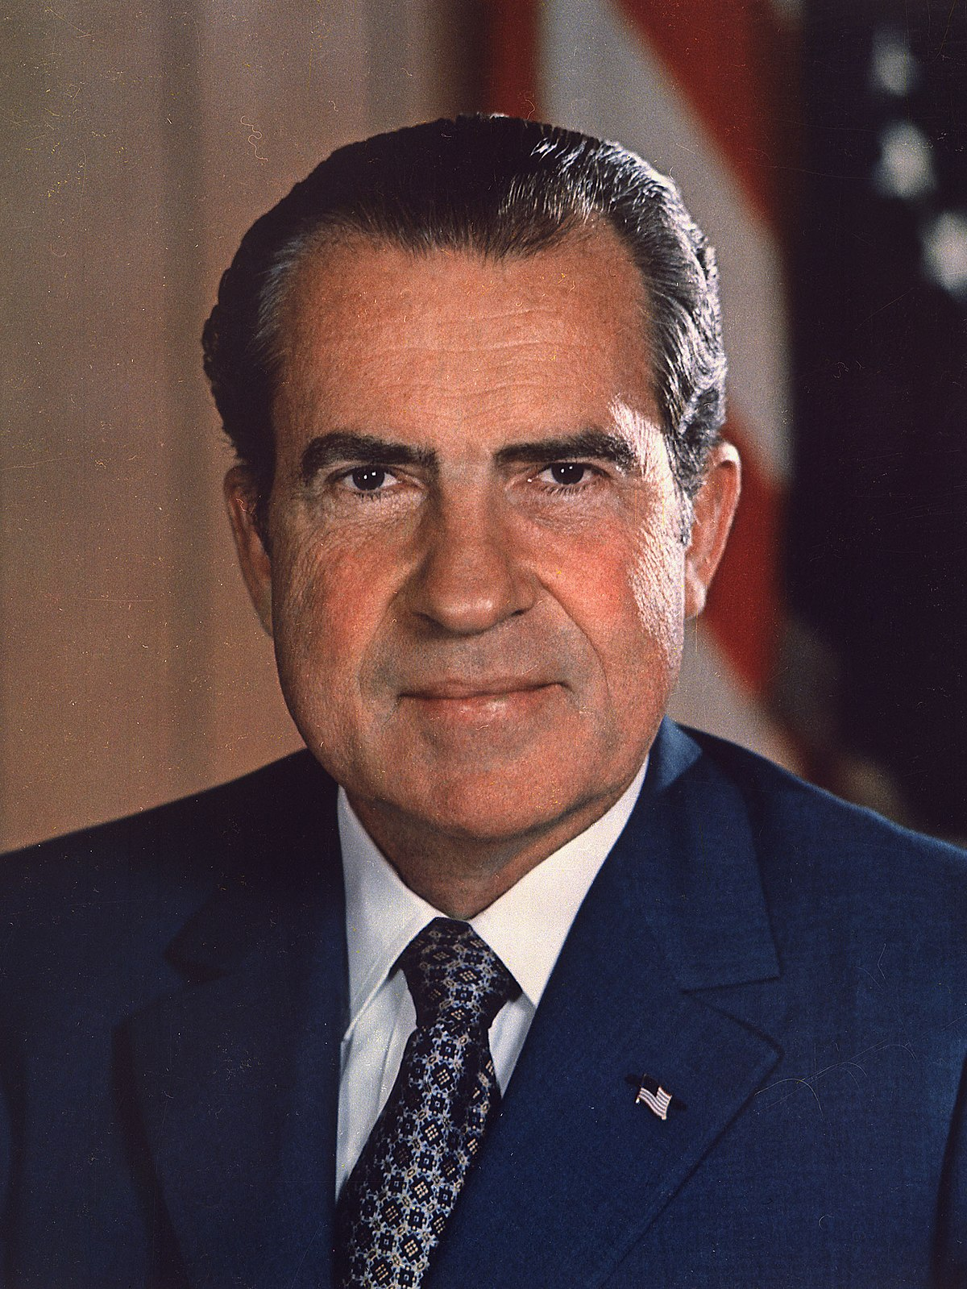
Richard Nixon:1971-1973
China’s Ping-Pong diplomacy
Nixon’s five steps to relax relations with China
Kissinger’s secret visit to China
Nixon’s visit
the first ever visit to China made by an incumbent US president
the first ever visit made by a US president to a country without formal diplomatic relations with the US
Shanghai Communique
1973.2.22 communique for setting up a liaison office in each other’s capital,
functioned largely as embassies,
played a positive role in maintaining regular communication between China and the US.
Sino-US Relations: 1949-1989 \\ normalization
033

Slide 34
Richard Nixon:1971-1973
slow advancement because of
Taiwan question, being unwilling to abandon its old friend; continue its security obligation (treaty)
US looking for detent with the Soviet Union; Sino-US relations was a secondary concern, US-Soviet was a primary concern
domestic politics
Watergate scandal
Cultural revolution: ultra-leftist thinking; attack on Zhou Enlai, and on foreign policy altogether
Sino-US Relations: 1949-1989 \\ normalization
034

Slide 35
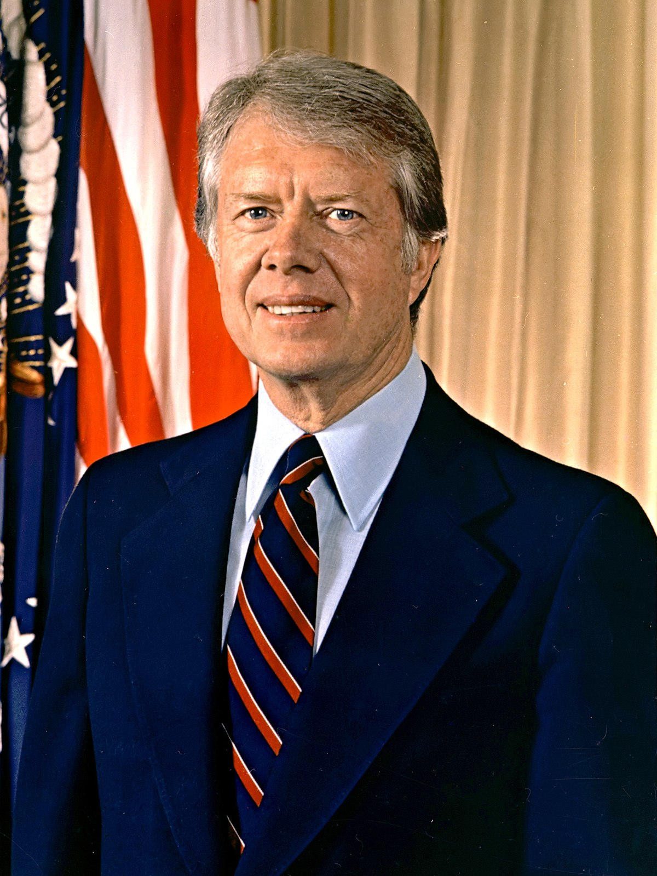
Jimmy Carter:1977-1981
Vance (Carter 1977)
priority: advance the talks on restricting strategic weapons with Soviet Union; strategic cooperation between US and China would hinder that priority
Vance’s visit to China, 8.22, little agreement on the Taiwan issue (Panama Canal Zone, needed to be signed by the Congress
Brzezinski (Carter 1978)
Sino-US Relations: 1949-1989 \\ normalization
035

Slide 36
Jimmy Carter:1977-1981
what stepped up the pace of China-US normalization??
Brzezinski (Carter 1978)
“a central stabilizing element of our global policy and a keystone for peace”
1978.5.20 Brzezinski visit to China, “no consulate in Taiwan after the normalization”
China’s need for modernization, learn from America, the biggest of the developed countries
Sino-US Relations: 1949-1989 \\ normalization
036

Slide 37
Jimmy Carter:1977-1981
1978.12.16 the joint Communique of the People’s Republic of China and the United States of America on the Establishment of Diplomatic Relations
significance
put an end to the long abnormal state of their bilateral relations
it was the most important geo-strategic change in the Cold War period
a boost for cross-state relations, Taiwan authorities were further isolated
Sino-US Relations: 1949-1989 \\ normalization
037

Slide 38
Jimmy Carter:1977-1981
Taiwan Issue
Carter administration kept all these secret from Taiwan, sent deputy secretary of state Warren Christopher to Taiwan to discuss US-Taiwan relations after 1979
the issue official exchange vs non-official exchanges
American Institute in Taiwan, all contacts between US and Taiwan were to be conducted through this institute, a non-profit non-governmental organization
its counterpart, Coordination Council for North American Affairs, America turns a blind eye to how Taiwan chose to interpret it
US congress passed the Taiwan Relations Act, focusing on maintaining peace in Western Pacific region; but it had the problem of regarding Taiwan as a nation state, which sowed the seed for future disputes
Sino-US Relations: 1949-1989 \\ normalization
038

Slide 39
Jimmy Carter:1977-1981
US congress passed the Taiwan Relations Act
focused on maintaining peace in Western Pacific region;
but had the problem of regarding Taiwan as a nation state, which sowed the seed for future disputes
Sino-US Relations: 1949-1989 \\ normalization
039

Slide 40
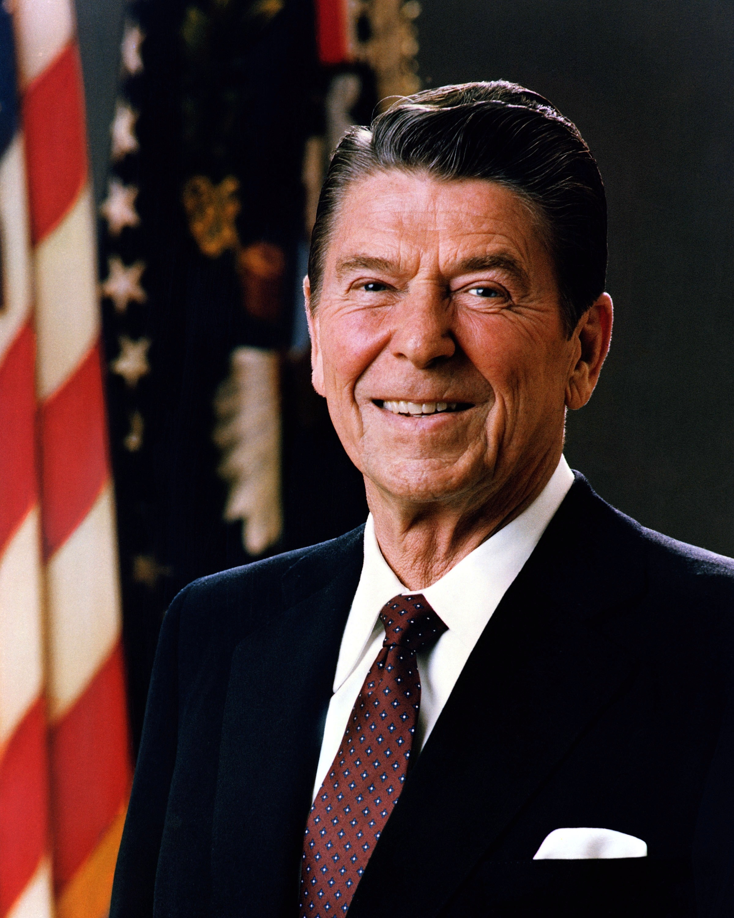
Ronald Reagan:1981-1989
as a candidate, attacked Carter’s China policy harder than any other candidate; willingness to sell Taiwan all the weapons it wanted; rebuilding official relations with Taiwan
advised to pull back from his extreme remarks on China policy in order to move closer to the mainstream; sent his running mate Bush to China
Chinese government attached great importance to China-US relations but would never trade its principles
Sino-US Relations: 1949-1989 \\ normalization
040

Slide 41
Ronald Reagan:1981-1989
Secretary of State Alexander Haig
perception: American strategic interest lay in mainland China rather than Taiwan; to continue advancing along the normalization road
action:
verbal commitment
improve trade relations, to change the status of China to “a friendly but non-allied country”; transfer some advanced technologies
visit China in June 1981, improving each side’s understanding of the other’s position
Sino-US Relations: 1949-1989 \\ normalization
041

Slide 42
Ronald Reagan:1981-1989
factors encouraging the Reagan administration to negotiate with China on a third communique
Cancun Conference in Mexico, Zhao Ziyang met with Reagan and discussed the arms sales issue
Allen who used to obstruct Haig’s opinion left office
the crisis in Poland
1982 August 17 Communique
“The US does not seek to carry out a long-term policy of arms sales to Taiwan, that its arms sales to Taiwan will not exceed, either in qualitative or in quantitative terms, the level of those supplied in recent years since the establishment of diplomatic relations; and it intends gradually to reduce its sale of arms to Taiwan, leading over a period of time, to a final resolution,”
Sino-US Relations: 1949-1989 \\ normalization
042

Slide 43
Ronald Reagan:1981-1989
factors encouraging the Reagan administration to negotiate with China on a third communique
Cancun Conference in Mexico, Zhao Ziyang met with Reagan and discussed the arms sales issue
Allen who used to obstruct Haig’s opinion left office
the crisis in Poland
1982 August 17 Communique
“The US does not seek to carry out a long-term policy of arms sales to Taiwan, that its arms sales to Taiwan will not exceed, either in qualitative or in quantitative terms, the level of those supplied in recent years since the establishment of diplomatic relations; and it intends gradually to reduce its sale of arms to Taiwan, leading over a period of time, to a final resolution,”
In the aftermath,
China insists on building independent foreign policy. there were all-round development in bilateral relations during Reagan’s presidency
Sino-US Relations: 1949-1989 \\ normalization
043

Slide 44
THANKS!
DO YOU HAVE ANY QUESTIONS?
Presented by ZHANG Wei
Date_
2022/4/6
holazhangwei@163.com
Please keep this slide for attribution

